Slide 1
Facilities Update
Presented to:
Garden Grove Unified School District
Bond Oversight Committee
May 8, 2018
Presented by: Jerry Hills & Kevin Heerschap

Slide 2
Measure A: Project List
Completed, Under Construction
Elementary
Basic Modernization: Completed at 34 schools
Modernization & HVAC/Ancillary Improvements: 13 schools
Intermediate
Modernization & HVAC and Ancillary Improvements: 9 schools
Basic Modernization: 2 Schools. Bell & Jordan ATP (Existing AC)
High School
Modernization & HVAC/Ancillary Improvements : 5 schools
Bolsa, Grove, Santiago, Rancho, Los Amigos
Modernization & HVAC/Ancillary Improvements: LQ/Pacifica Admin and Industrial Arts Buildings
Modernization: Santiago(HVAC/Ancillary Improvements under “P”)
Measure P Planning
Seismic & HVAC design

Slide 3
Measure P: Project List
Completed, Under Construction, Future
Santiago HS HVAC/Ancillary Improvements
Seismic (Pacifica/La Quinta)
Athletics Stadium Upgrades(GGHS/BGHS)
Gyms/Locker Rooms (La Quinta/Pacifica)
Elementary HVAC/Ancillary Improvements (25 schools)
Roofing (19 schools)
Electrical Switchgear Replacement (11 schools)
HVAC and Insulation Improvements (13 schools, Edgar, DO)

Slide 4
Measure P Overview
HVAC
Seismic Replacements
Classrooms/Gyms
Stadium Renovation
Projects
Completed, Under Construction, Future

Slide 5
Elementary HVAC Projects
5 Projects completed summer 2017
19 future elementary projects
All 19 projects have been awarded
2018: 7 Schools - Bryant, Parkview, Simmons, Violette, Warren, Woodbury, Garden Park
2019: 6 Schools TBD
2020: 6 Schools TBD

Slide 6
Seismic Replacement
LQ/Pacifica Classroom Buildings
LQ/Pacifica Gym Locker Buildings

Slide 7
Seismic Replacement
Phase 1- Start June 2016, construction of 32 Classrooms/
Demo of existing CR building -Completion September 2017
Phase 2- Start June 2017, Construction of 32 Classrooms and Cafeteria/ Demo of existing CR and Cafeteria Building
-Completion August 2018 Phase 3- Start June 2018, Construction of Media Center and Theater -Completion – December 2019
PACIFICA/LA QUINTA HIGH SCHOOL BUILDINGS

Slide 8
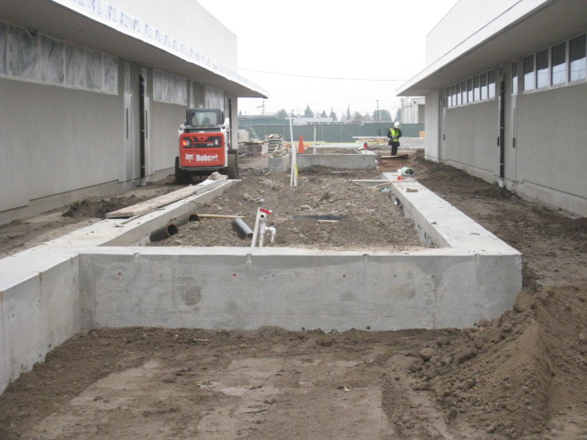
Seismic Replacement
Pacifica HS
New Building Corridors with Seat walls

Slide 9
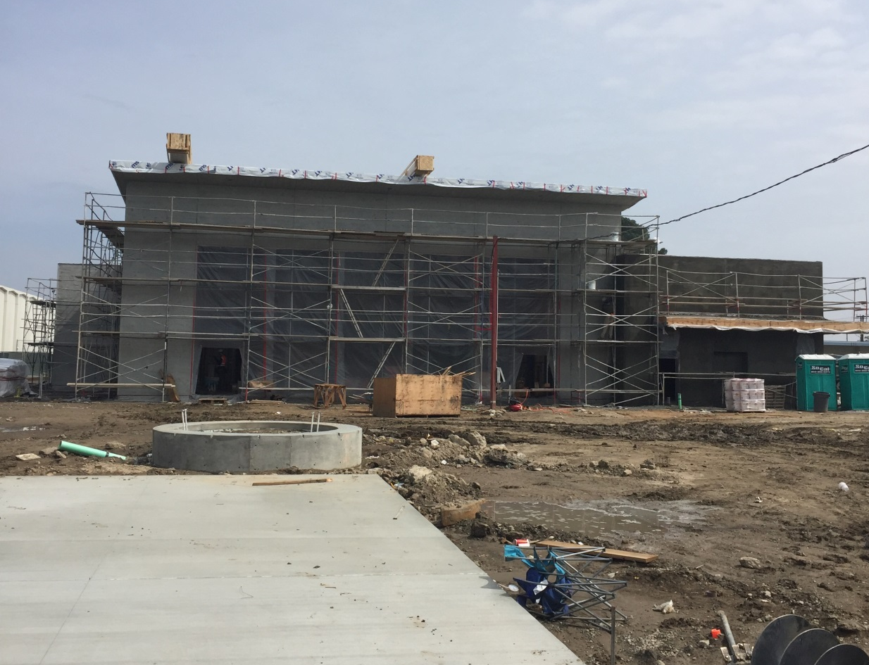
Seismic Replacement
Pacifica HS
New Cafeteria Front

Slide 10
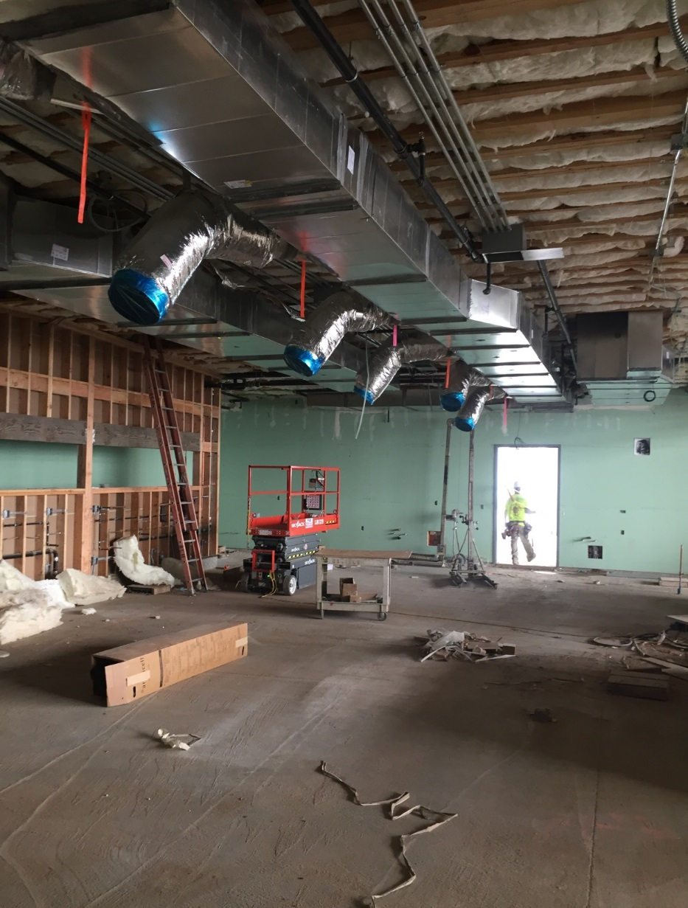
Seismic Replacement
Pacifica HS
New Cafeteria Staff Dining Area

Slide 11
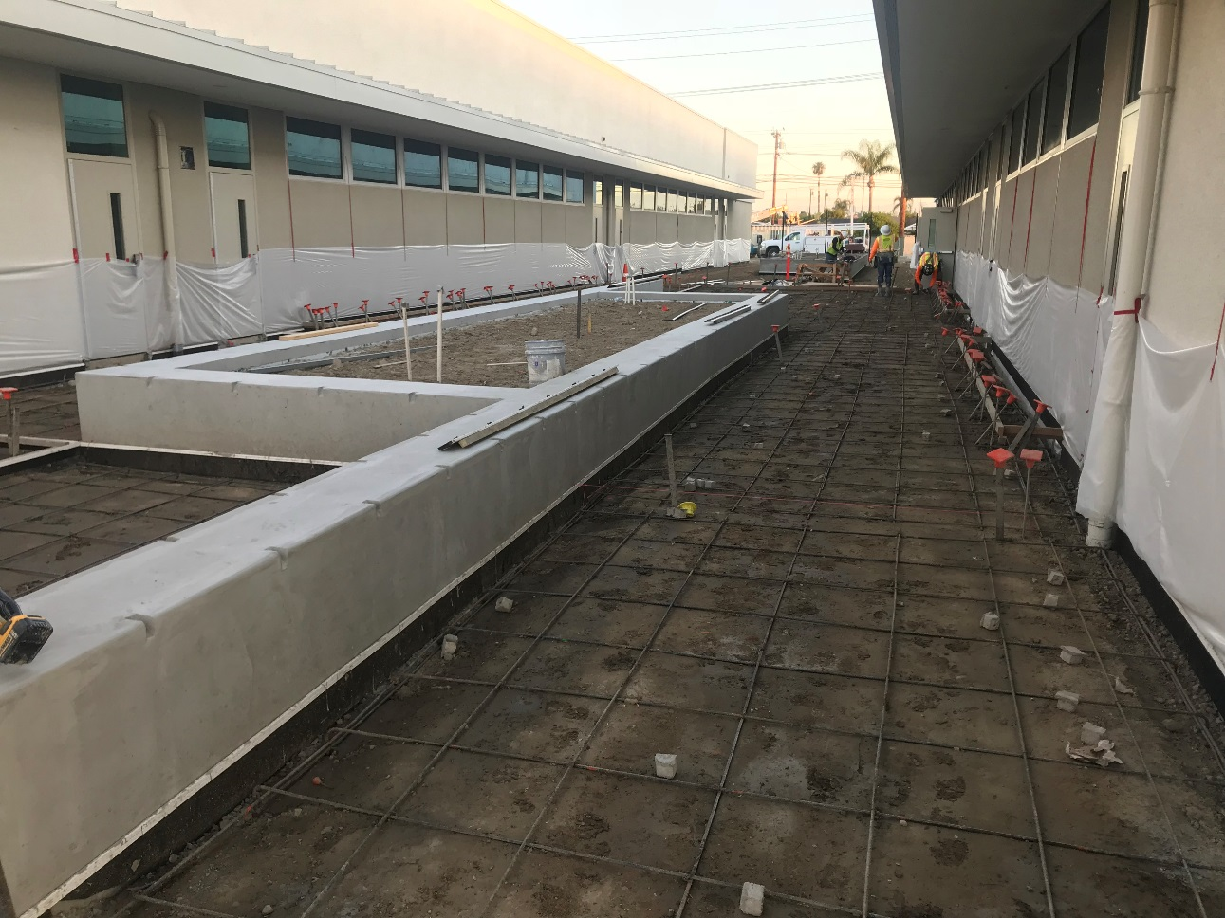
Seismic Replacement
La Quinta HS
New Building Corridors with Seat walls

Slide 12
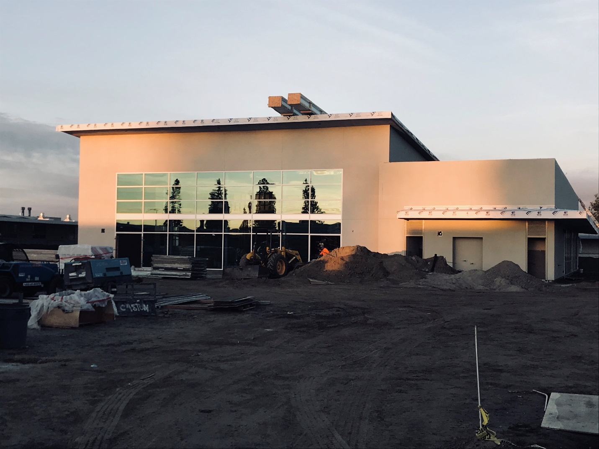
Seismic Replacement
La Quinta HS
New Cafeteria Front

Slide 13
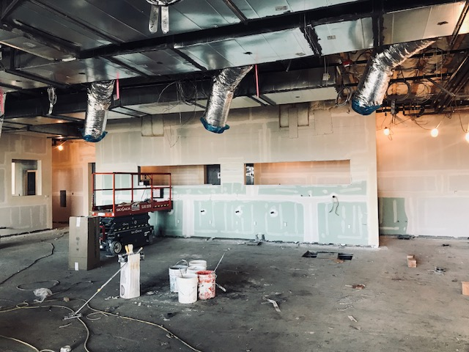
Seismic Replacement
La Quinta HS
New Cafeteria Staff Dining Area

Slide 14
Seismic Replacement
Seismic Gym Locker Buildings
Pacifica and LQ
DSA Approved in September 2017
Gymnasium, Locker Rooms, Pool
Approved for Partial State Funding
Anticipated Construction Start 2019

Slide 15
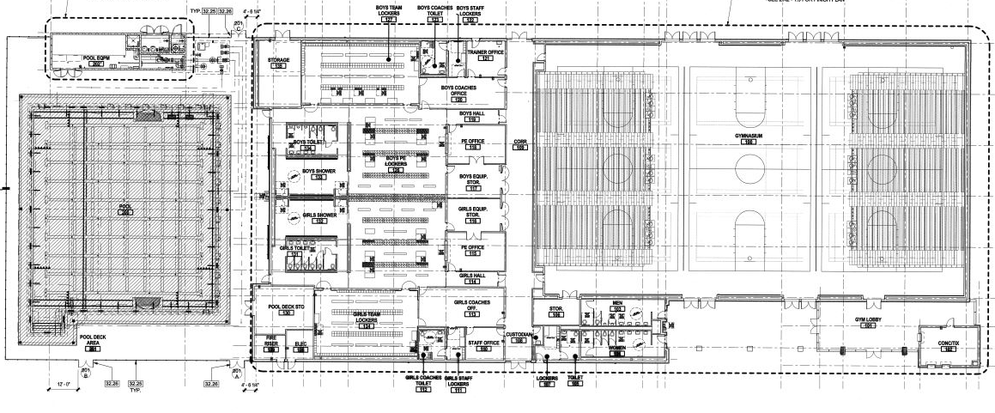
Pacifica/LQ gym locker

Slide 16
Stadium Renovations
Michael A. Monsoor
Memorial Stadium
(Completed September 2017)
Bolsa Stadium
(Construction to begin Winter 2018)

Slide 17
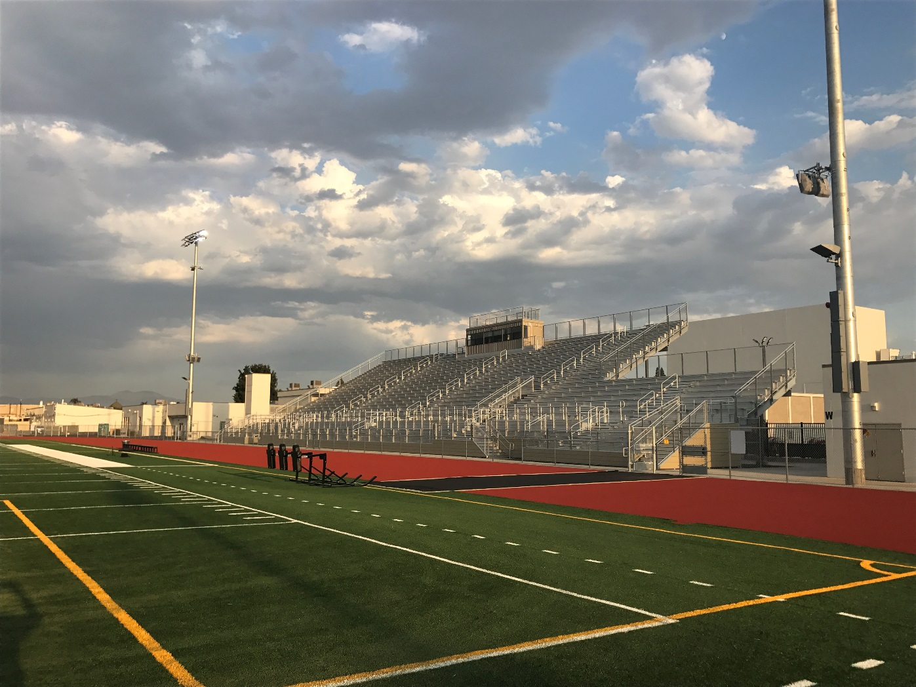
Monsoor Stadium
Garden Grove HS
Completed September 2017

Slide 18
Bolsa Stadium Schedule
Currently in design
Plans will be submitted to DSA June 2018
Proposals to be received October 2018
Anticipated award November 2018
Construction begins December 2018
(as soon as football is over)

Slide 19
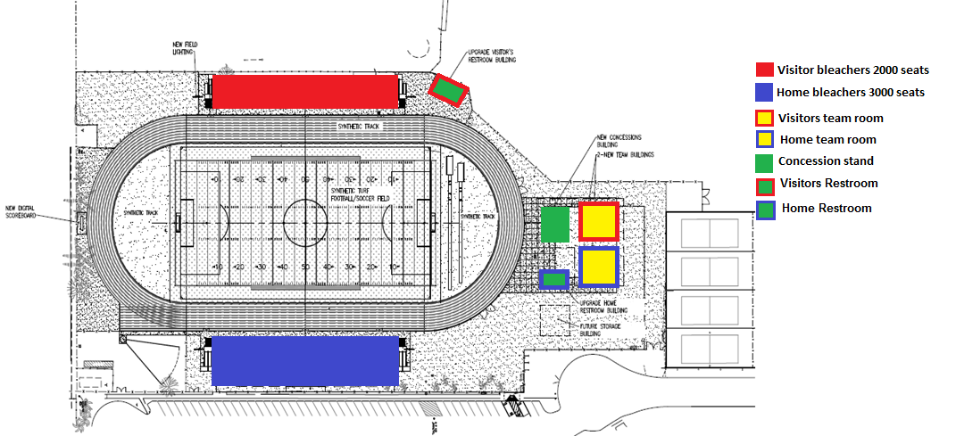
Bolsa Stadium
Proposed Layout

Slide 20
Project List
Completed, Under Construction, Future
Santiago HS HVAC
Seismic (Pacifica/La Quinta)
Athletics Stadium Upgrades(GGHS/BGHS)
Gyms/Locker Rooms (La Quinta/Pacifica)
Elementary HVAC (25 SCHOOLS)
Roofing (19 SCHOOLS)
Security, Fencing, Intrusion Alarms
HS Gym Floor/Bleachers (SHS, RAHS, GGHS, LAHS, BGHS)
HS Pool Renovations(SHS, LAHS, BGHS, RAHS)
Don Wash Auditorium
Resurface Tennis Courts (All HS)
Varsity Baseball Dugouts (All HS)
Total estimated cost $375,300,500

Slide 21
Under Construction
Bolsa Building R
Contract has been issued
Scheduled to begin June 2018
Completion 2019

Slide 22
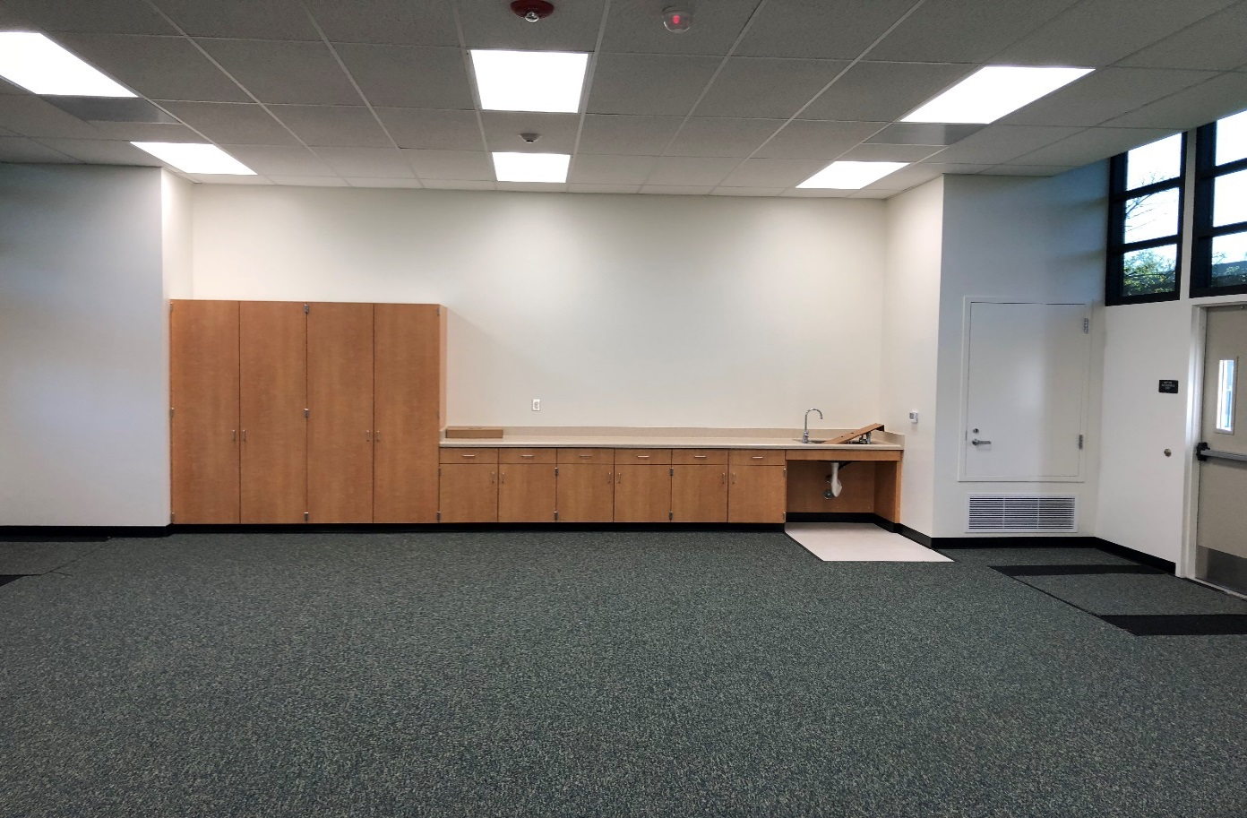
Under Construction
Ralston IS
Typical Classroom Interior
Casework, Flooring, Dropped Ceiling, LED Lights, Energy Efficient Windows

Slide 23
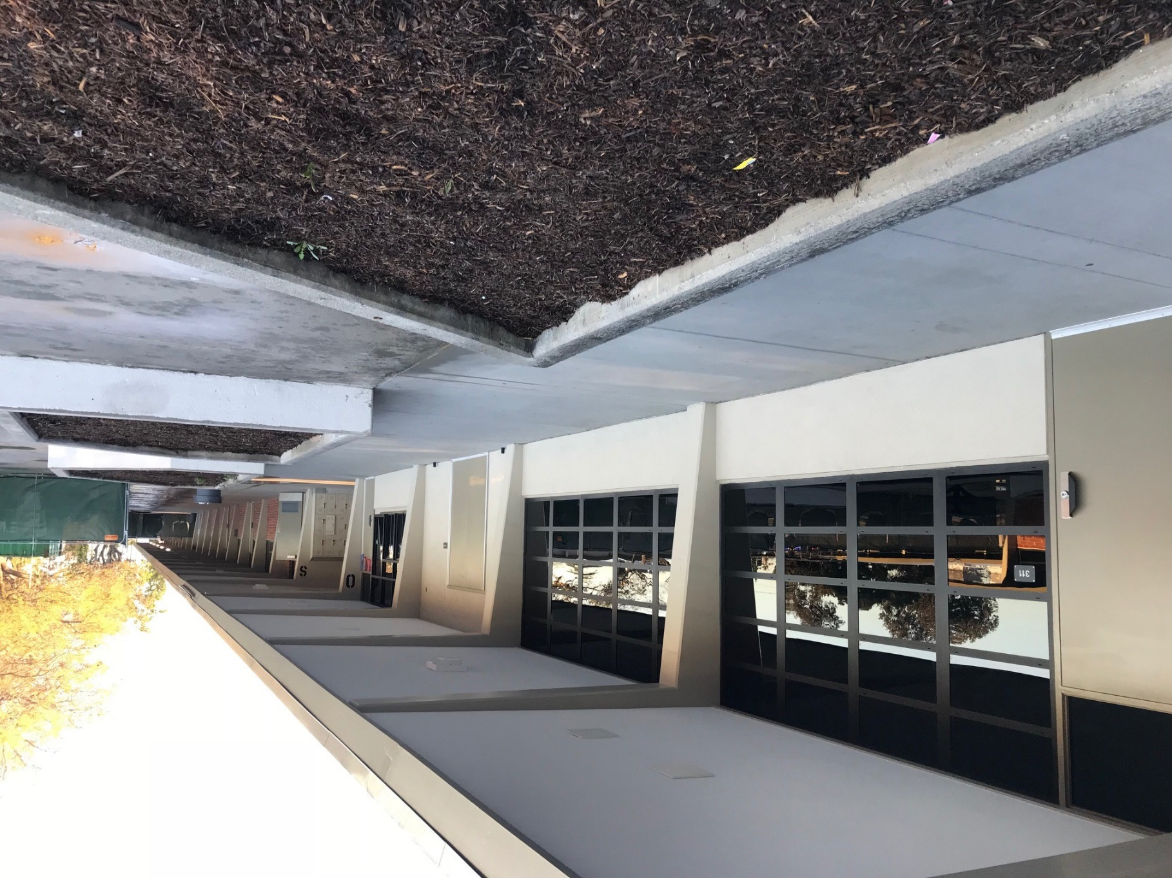
Under Construction
Bolsa Grande
ASB Store
Energy efficient windows, Accessible Doors,
ADA Path of Travel

Slide 24
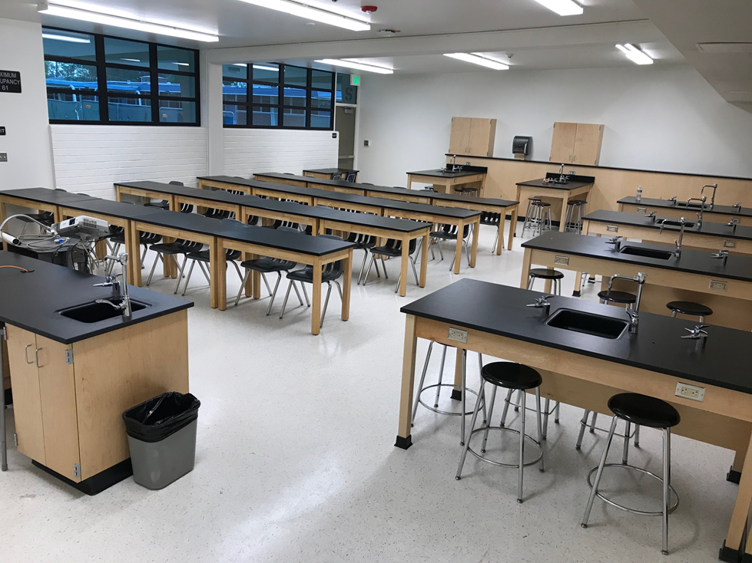
Under Construction
Bolsa Grande
New Science Room Interior
Casework, Gas, Plumbing, Flooring, LED Lights, Energy Efficient Windows

Slide 25
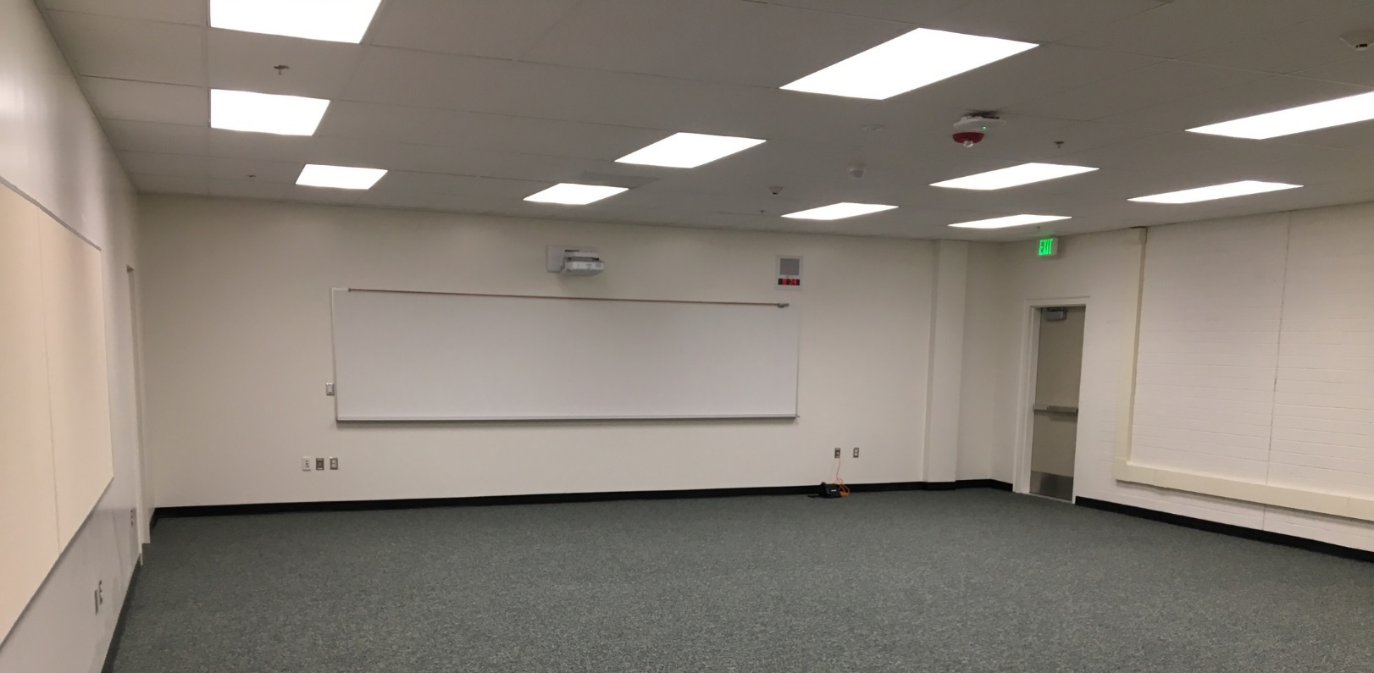
Under Construction
Los Amigos HS
Typical Classroom Interior
Flooring, Dropped Ceiling, LED Lights, Teaching Wall Short Throw Projector, Atlas Clock

Slide 26
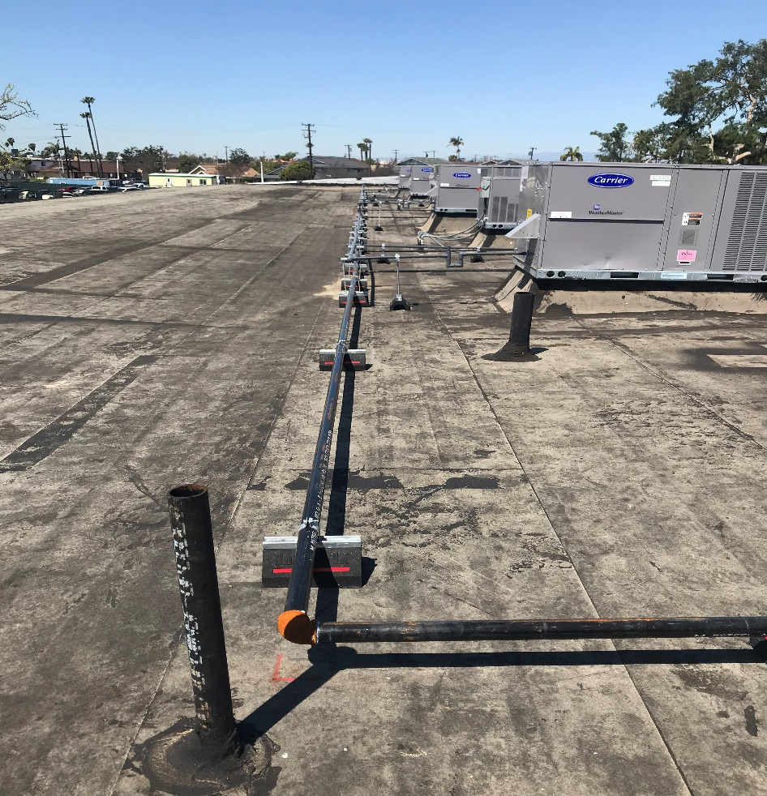
Under Construction
Santiago HS
Phase 4
New AC units
Roofing getting ready to be Made water tight

Slide 27
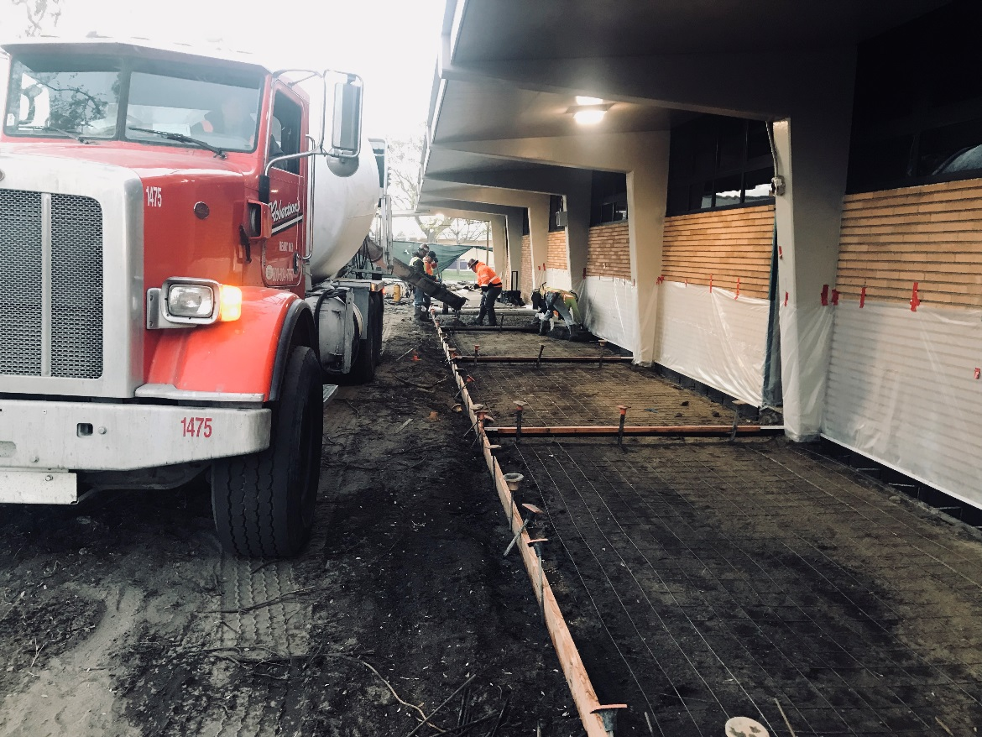
Under Construction
Santiago HS
Phase 4
Pouring Concrete For New Accessible Pathway

Slide 28
QUESTIONS

Slide 29
Facilities Update
Thank You!

